Slide 1




Asking the right questions
Getting the right answers from your data
Shannon McWeeney, PhD
13th January 2016

Slide 2
Importance of Question + Scope
Guidelines for Study Design

Slide 3
Study Design
Define Question
Type of Study / Method of data Generation
Sampling Considerations

Slide 4
Defining Your Question
Why is this research important?
What is it that we don’t know or fully understand?
What have other researchers in my field done?
What areas need further exploration?
Can my study help fill in these gaps or lead to greater understanding?

Slide 5
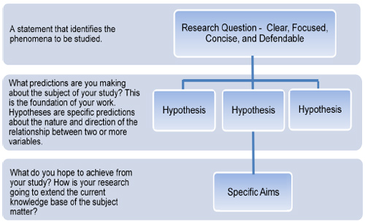
From Question->Hypothesis
Characteristics of a good hypothesis
Gives insight into the proposed research question;
Is measurable and testable;
Is developed directly from the experiences of the researcher and should have a well-founded rationale for all proposed hypotheses.

Slide 6
Guidelines for Good Design
Clarity
Clear hypothesis.
Does your question match your analysis method?
Simplicity
Multiple Questions
Data Snooping

Slide 7
Guidelines for Good Design
Confounding Factors
Distinguish between variation of interest and other sources of variation.
Replicates
Type of replicates
Can you detect the effect if it is present?

Slide 8
Assessing Significance
P value (R.A. Fisher): Informal way to judge whether evidence was “significant” (i.e., worthy of a second look)
Formulate ‘Null hypothesis’
Set up statistical test assuming null hypothesis is true
Calculate the chances of getting results at least as extreme as what was actually observed. This probability = P value.
Smaller P value = greater the likelihood that the straw-man null hypothesis was false
Context: Part of the research process / life-cycle

Slide 9
Evidence Based Decisions
Rigourous and Objective Framework
Key Concepts:
Statistical Power
Estimation of False positives and False Negatives
Explicit statements about effect size and variability
This framework was incorrectly hybridized with P-value concept.
“THE P VALUE WAS NEVER MEANT TO BE USED ^{THE WAY IT’S} ^{USED TODAY}”

Slide 10
What we should be asking
What are the odds that a hypothesis is correct?
Depends on how plausible the hypothesis is in the first place.

Slide 11
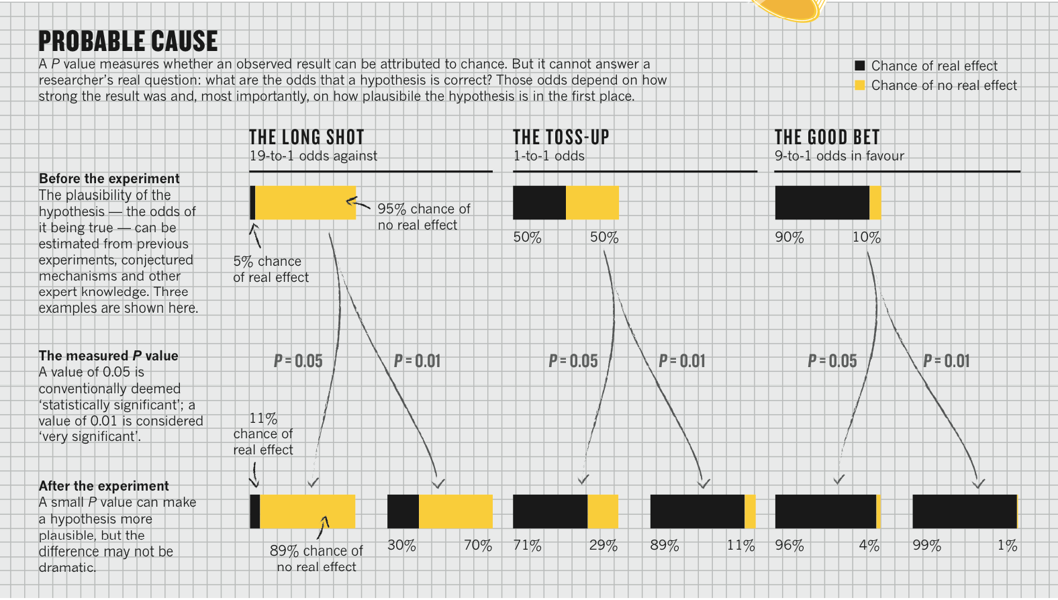
Rephrasing the Question

Slide 12
Key Danger
“P-hacking” : “is trying multiple things until you get the desired result, even unconsciously
Monitoring data while it is being collected
Exploratory studies confused with confirmatory studies

Slide 13
Three Questions
What is the evidence?
What should I believe?
What should I do?

Slide 14
Case Study
Google Flu

Slide 15
What Do we have here?
A patient comes into your office in January with the following complaints:
Body aches, muscle and joint pain, headache, a sore throat and a unproductive cough with occasionally harsh breathing
Fever, which ranged from 100 to 104 F and lasted for a few days
Felt sudden dizziness, weakness and pain while at work
Constipation
Bloody nose, red mucous membranes
Family members have noted he is “not acting like himself”
What is a possible diagnosis?

Slide 16
What If I told you….
The year is not 2016 but 1918
All of those symptoms were what was being reported in medical literature at the time
Excerpts from JAMA, 10/3/1918 and 1/25/1919
At time, most basic clinical guideline was the temperature
Other Data collected:
Pulse rate "the pulse was remarkably slow,” (JAMA, 4/12/1919)
Respiration rate
White blood cells counts

Slide 17
Estimated Mortality Rate
Untreated Plague 100%
Untreated Anthrax 90%
Smallpox 30%
Spanish Influenza 2.5%
Public Health Reports (2001) Supp 2 / Vol.116

Slide 18

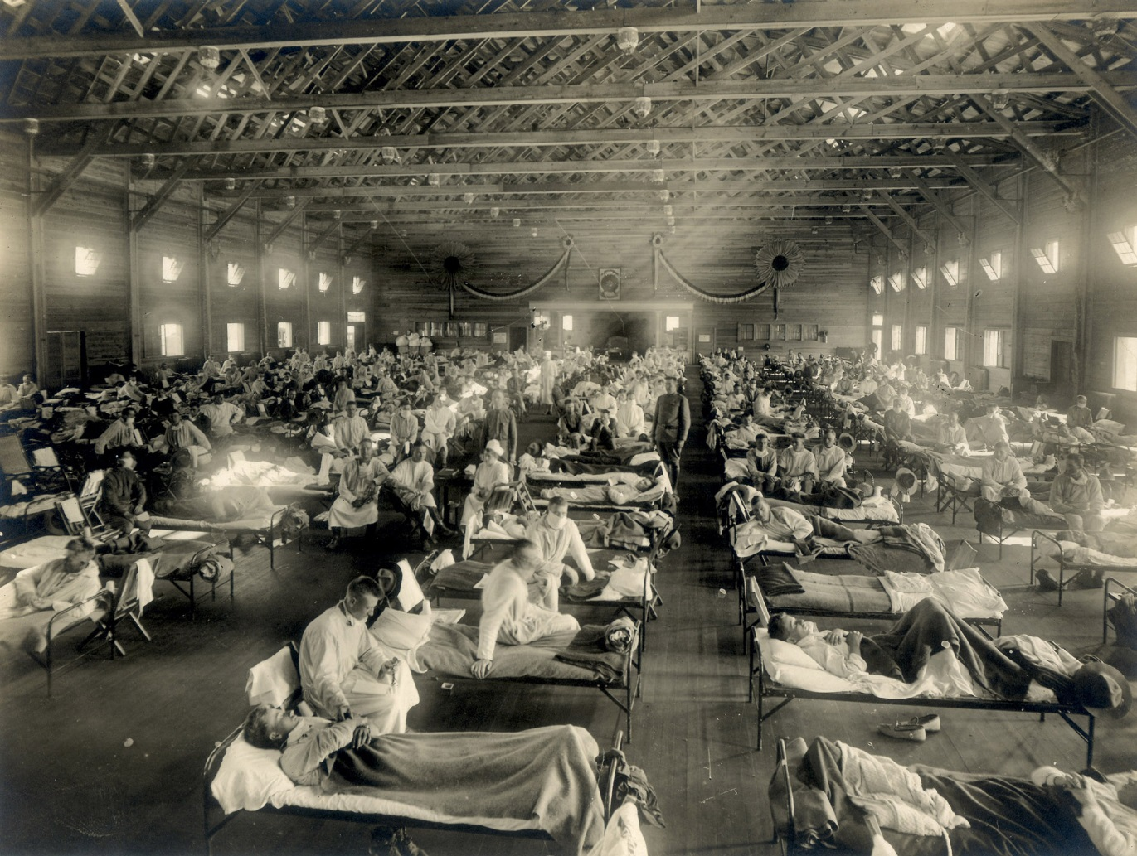
1918 Spanish Influenza
Notes:
18
In 1918 and 1919, the Spanish influenza outbreak sickened one of every four Americans and caused more than 500,000 deaths in this country alone and more than 40 million worldwide.
Image: Emergency hospital during influenza epidemic, Camp Funston, Kansas

Slide 19
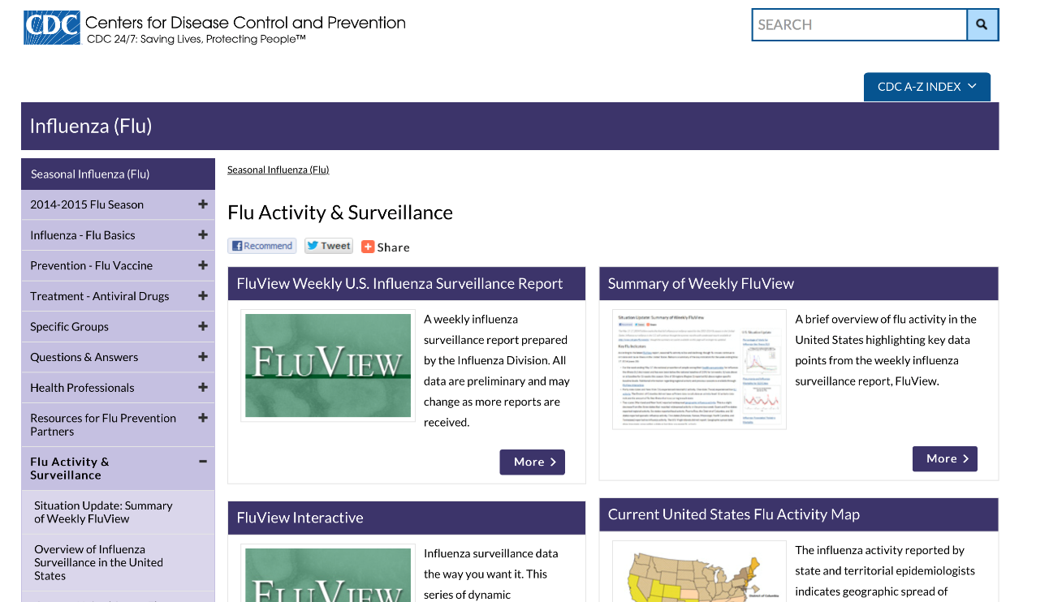
Traditional Surveillance
US Centers for Disease Control and Prevention (CDC) and European Influenza Surveillance Scheme (EISS)
Rely on both virological and clinical data, including influenza-like illness (ILI) physician visits.
CDC publishes national and regional data from these surveillance systems on a weekly basis, typically with a 1–2-week reporting lag

Slide 20
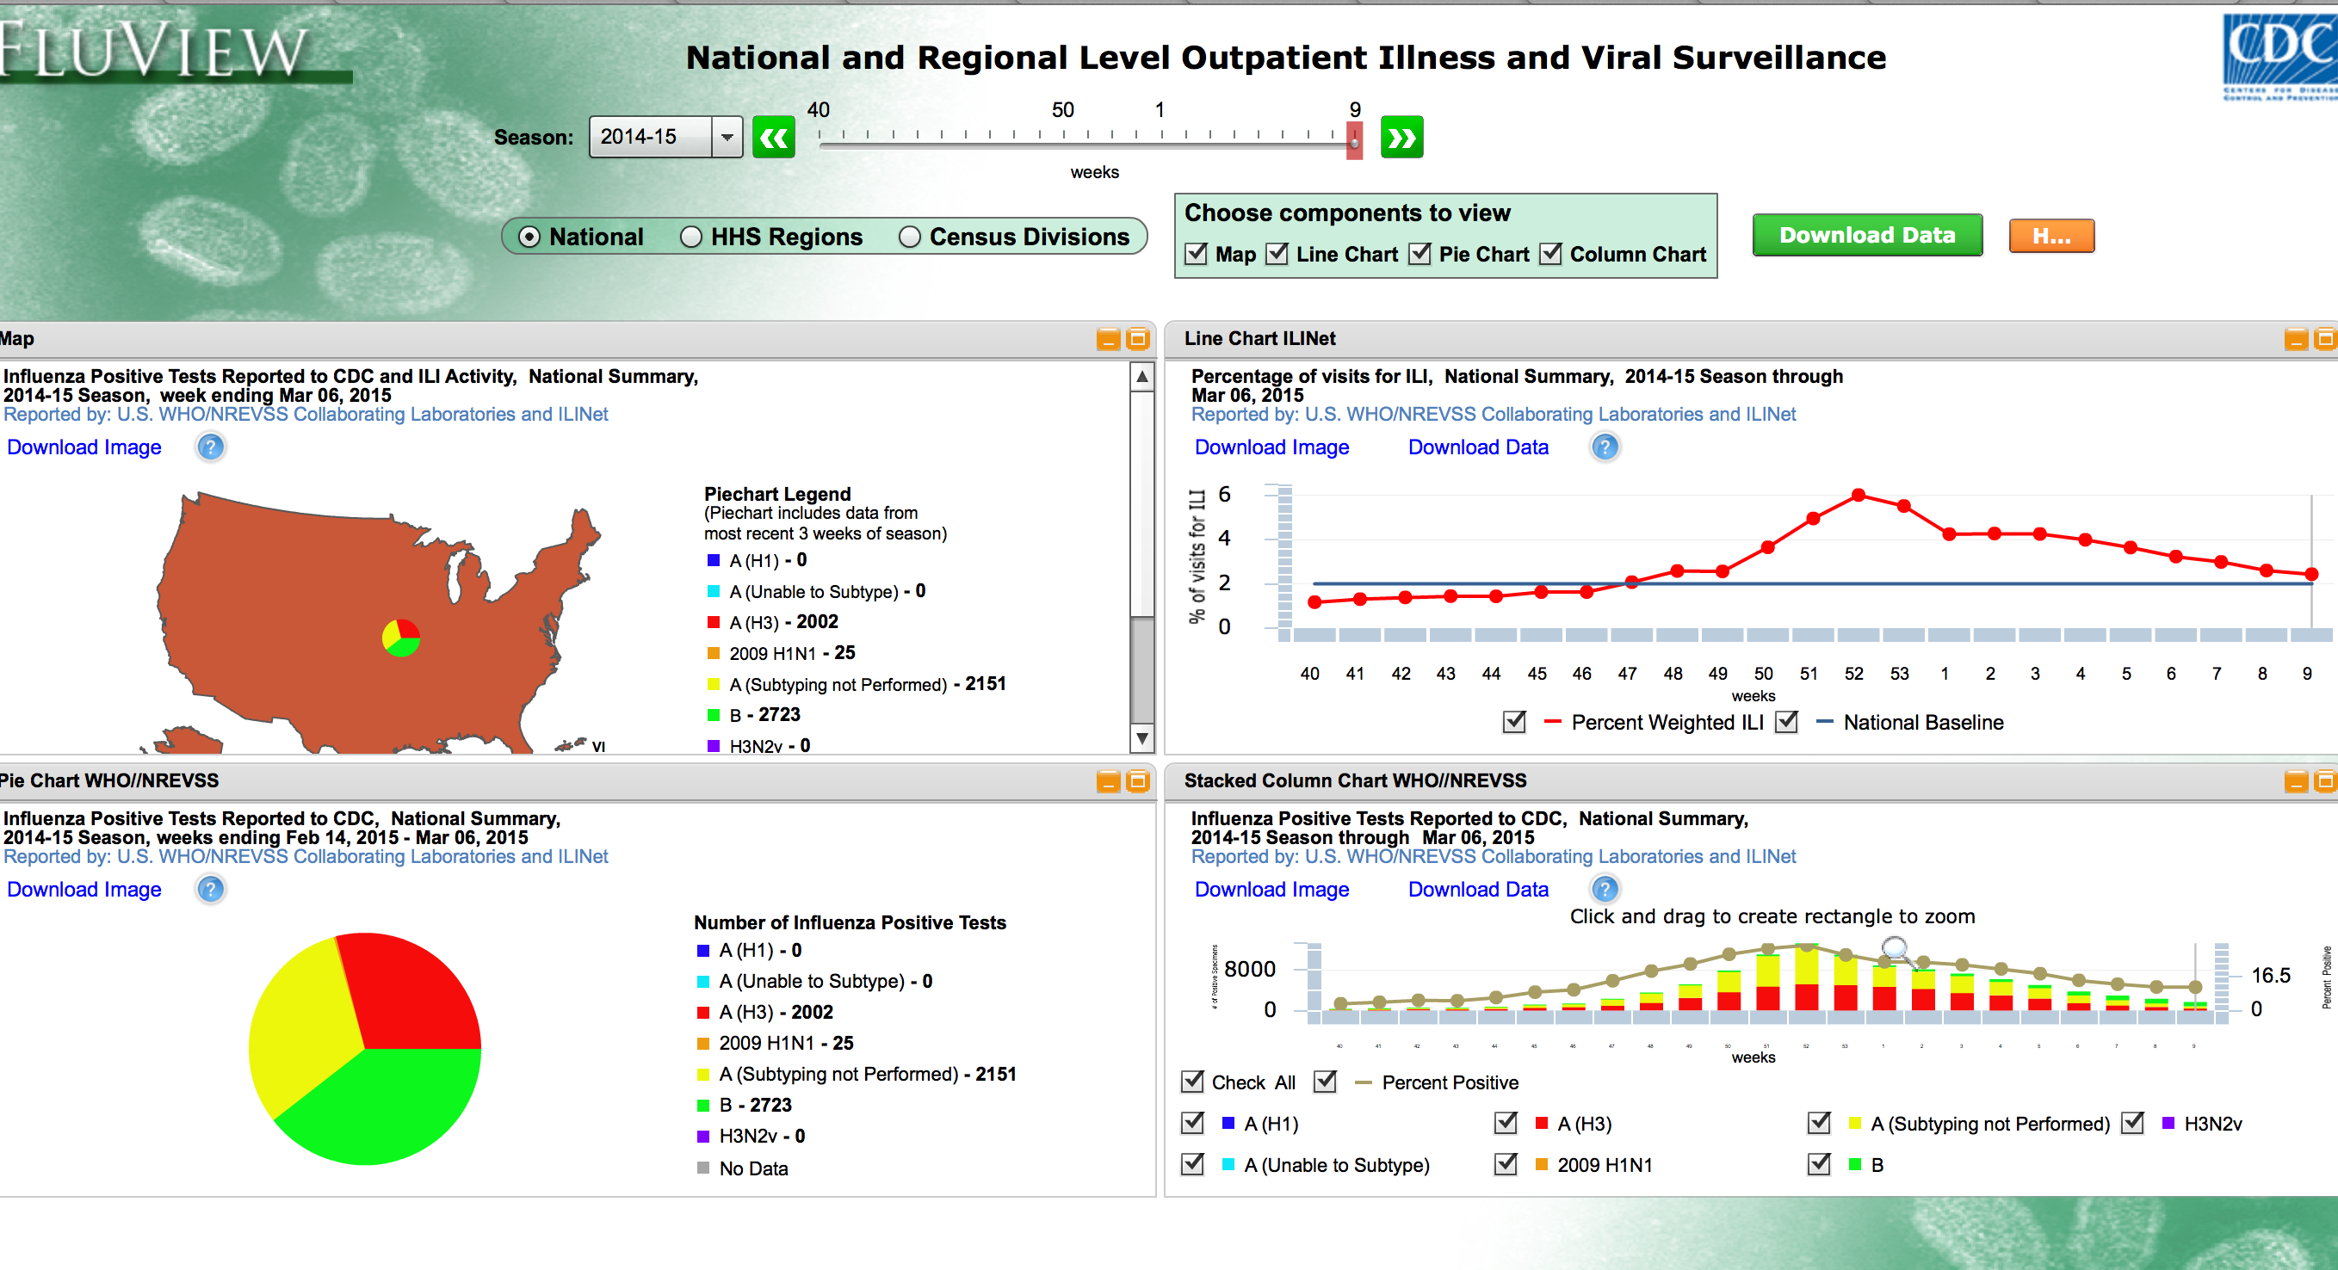
http://gis.cdc.gov/grasp/fluview/fluportaldashboard.html

Slide 21
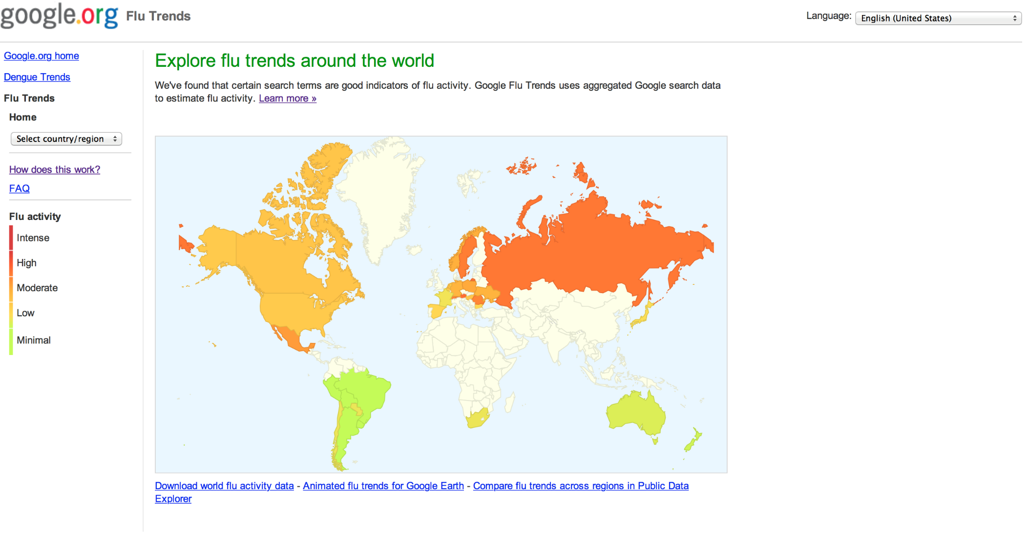
https://www.google.org/flutrends/

Slide 22
Problems Amenable to Analytics
When do we need Big Data

Slide 23
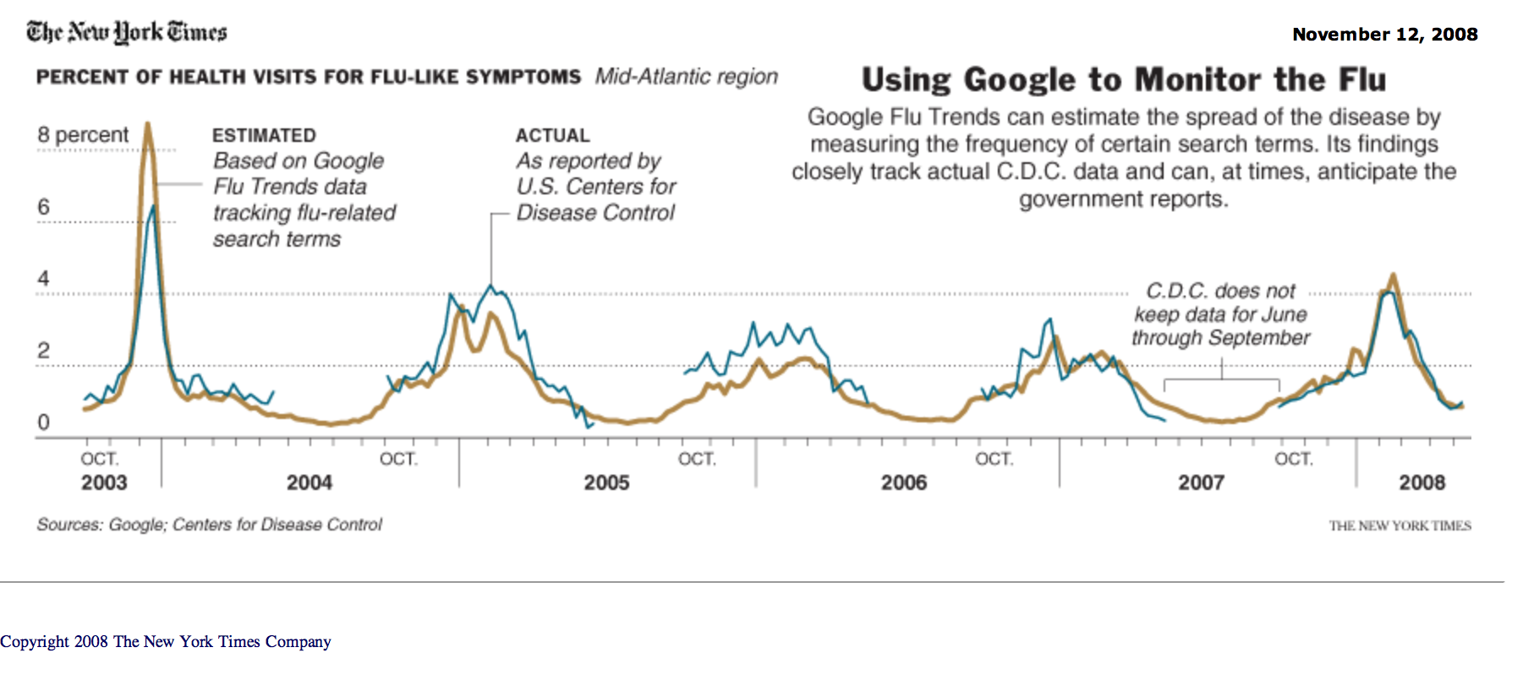

Slide 24
Google Flu Approach
5 years (2003-2008) of Google web search logs for modeling
Time series of weekly counts: 50 million most common search queries (US only)
No information about the identity of any user was retained
Normalized by dividing the count for each query in a particular week by the total number of online search queries submitted in that location during the week (query fraction)
Used the public historical CDC Influenza Sentinel Provider Surveillance Network data
Reported influenza-like illness (ILI) physician visits
Notes:
nine US surveillance regions with reported average % of all outpatient visits to sentinel providers that were ILI-related on a weekly basis

Slide 25
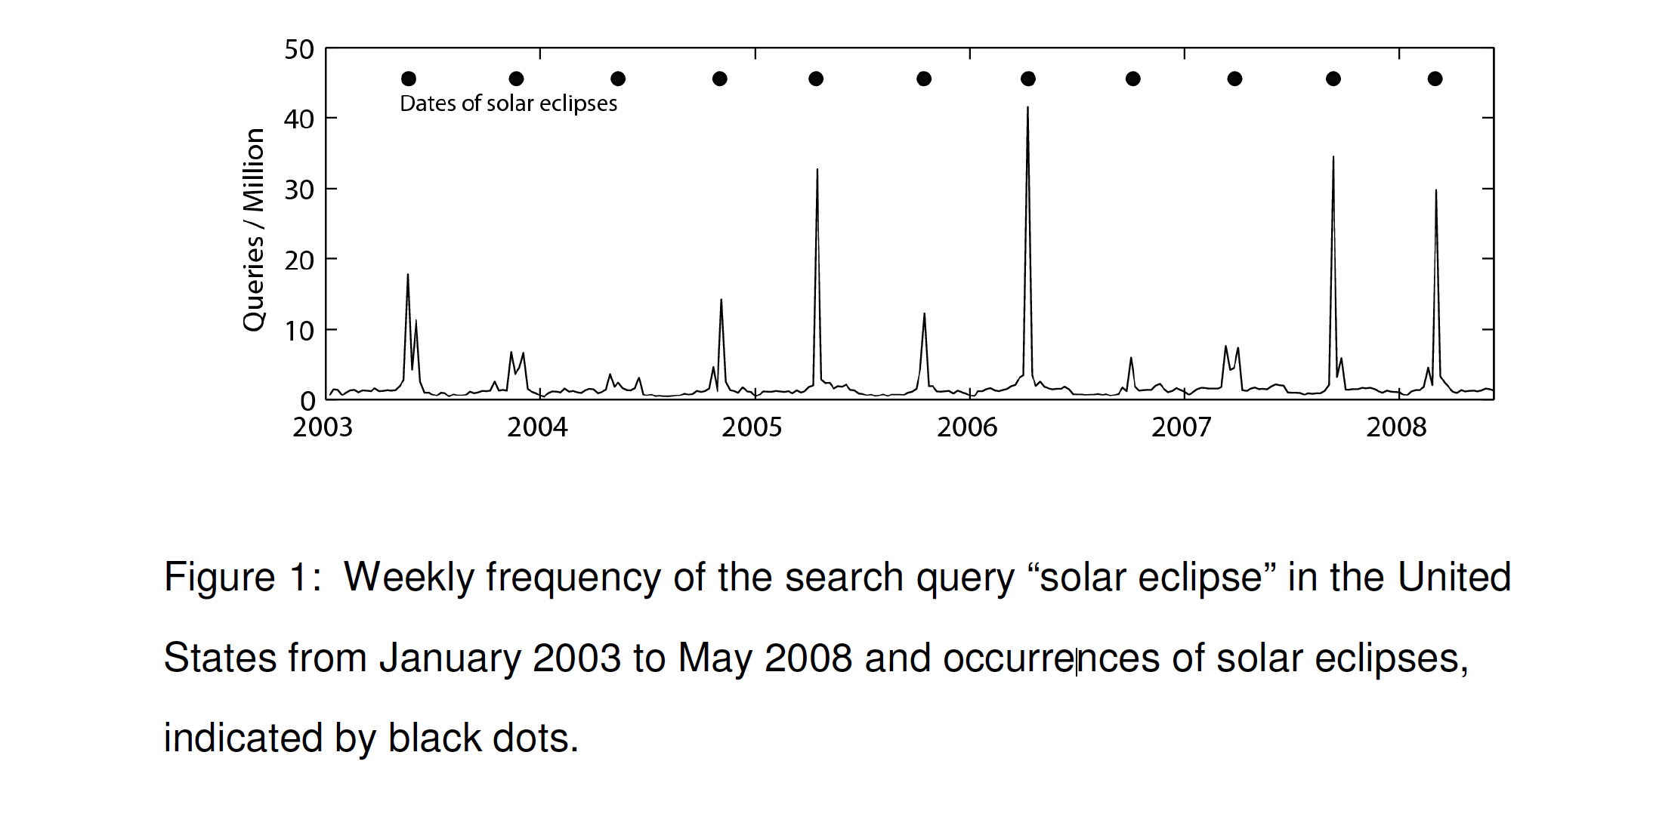

Slide 26
Automated Approach
Requires no previous knowledge about influenza
Measure how effectively model would fit the regional CDC ILI data if they used only a single query as the explanatory variable, Q(t)
Each of 50 million candidate queries was separately tested, to identify search queries which most accurately modeled the CDC regional ILI visit %
Approach rewarded queries that showed regional variations similar to the regional variations in CDC ILI data
Motivation: the chance that a random search query can fit the ILI percentage in all nine regions is considerably less than the chance that a random search query can fit a single location
Notes:
Notes: Estimates the probability that a random physician visit in a particular region is related to an ILI; this is equivalent to the percentage of ILI-related physician visits. A single explanatory variable was used: the probability that a random search query submitted from the same region is ILI-related (**Automated approach**) Fit a linear model using the log-odds of an ILI physician visit and the log-odds of an ILI-related search query sorted by mean Z-transformed correlation across the nine region. To decide which queries would be included in the ILI-related query fraction, Q(t), considered different sets of n top-scoring queries. Measured the performance of these models based on the sum of the queries in each set, and picked n such that we obtained the best fit against out-of-sample ILI data across the nine regions

Slide 27
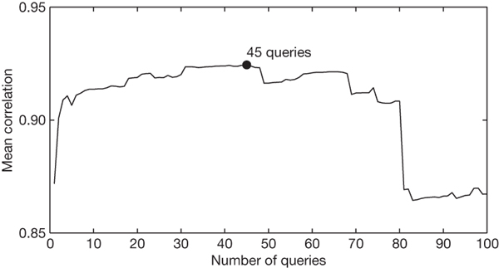

J Ginsberg et al. Nature 000, 1-3 (2008) doi:10.1038/nature07634
Notes:
Notes: Maximal performance at estimating out-of-sample points during cross-validation was obtained by summing the top 45 search queries. A steep drop in model performance occurs after adding query 81, which is 'oscar nominations'.
An evaluation of how many top-scoring queries to include in the ILI-related query fraction.

Slide 28
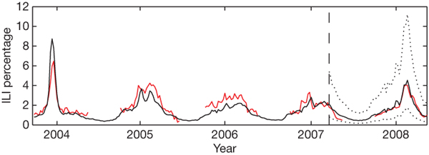
J Ginsberg et al. Nature 000, 1-3 (2008) doi:10.1038/nature07634
Model estimates for the mid-Atlantic region (black)
CDC-reported ILI percentages (red)
Notes:
Notes Using this ILI-related query fraction as the explanatory variable, they fit a final linear model to weekly ILI percentages between 2003 and 2007 for all nine regions together, thus obtaining a single, region-independent coefficient. The model was able to obtain a good fit with CDC-reported ILI percentages, with a mean correlation of 0.90 (min = 0.80, max = 0.96, n = 9 regions; Fig. 2). final model was validated on 42 points per region of previously untested data from 2007 to 2008, which were excluded from all previous steps. Estimates generated for these 42 points obtained a mean correlation of 0.97 (min = 0.92, max = 0.99, n = 9 regions) with the CDC-observed ILI percentages.

Slide 29
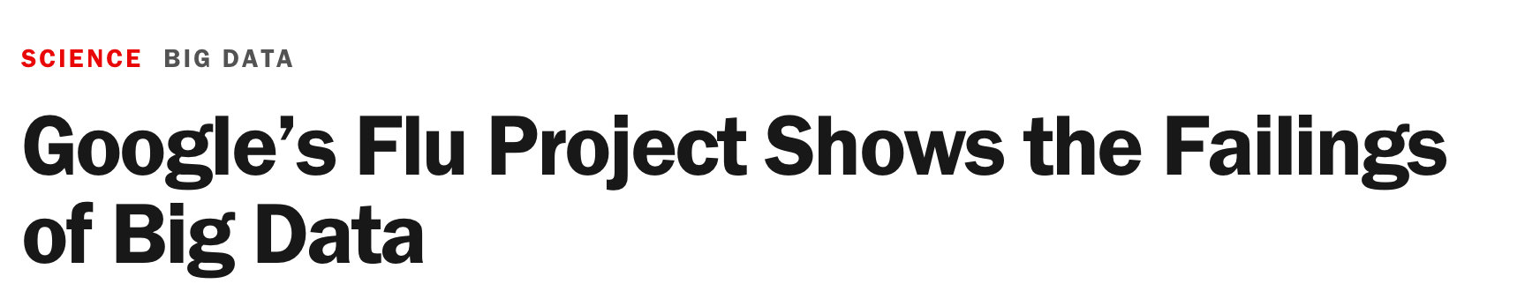
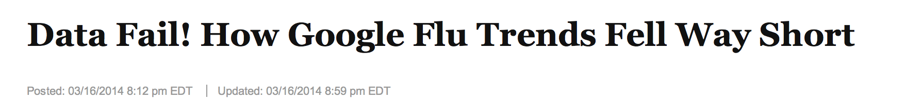
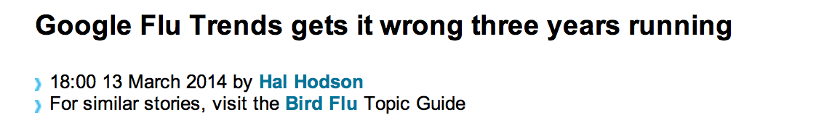
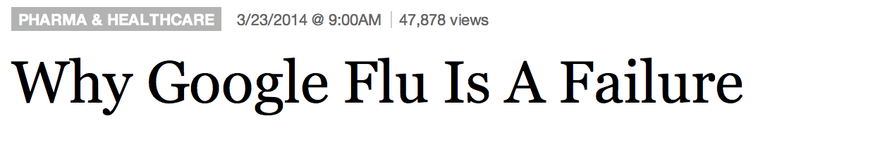

Slide 30
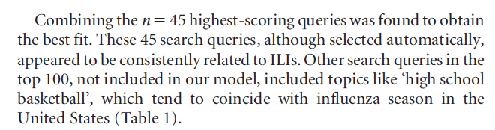
“Houston we have a problem….”
50 million search terms to fit 1152 data points!
Notes:
Notes: odds of finding search terms that match the propensity of the flu but are structurally unrelated, and so do not predict the future, were quite high. GFT developers were weeding out seasonal search terms unrelated to the flu but strongly correlated to the CDC data, such as those regarding high school basketball – should have been a warning that the big data were overfitting the small number of cases—a standard concern in data analysis. GFT completely missed the nonseasonal 2009 influenza A–H1N1 pandemic
“Part flu detector, Part winter detector“. Algorithm updated in 2009 and minor tweaks again in 2013

Slide 31
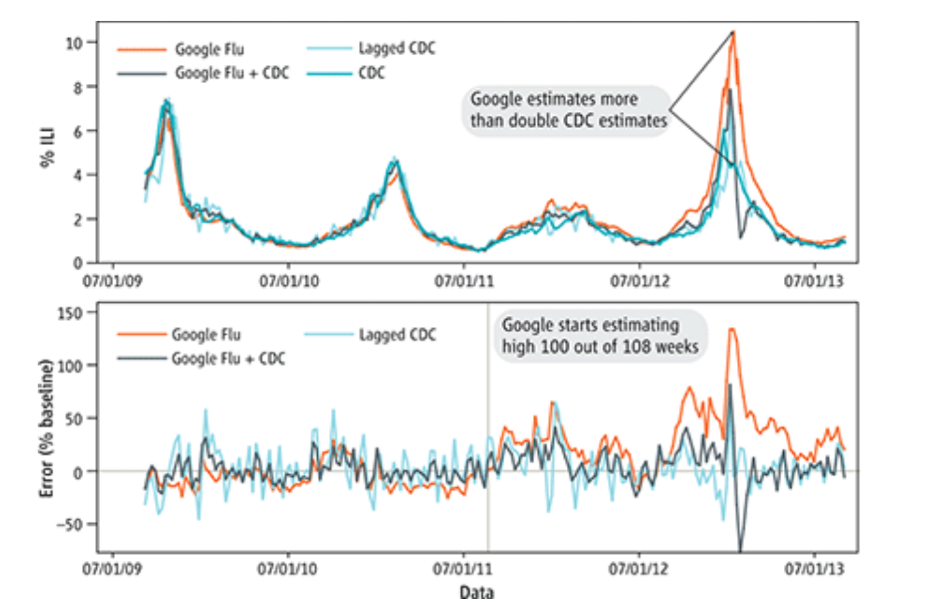
Notes:
Notes: GFT overestimated the prevalence of flu in the 2012–2013 season and overshot the actual level in 2011–2012 by more than 50%. From 21 August 2011 to 1 September 2013, GFT reported overly high flu prevalence 100 out of 108 weeks. (Top) Estimates of doctor visits for ILI. “Lagged CDC” incorporates 52-week seasonality variables with lagged CDC data. “Google Flu + CDC” combines GFT, lagged CDC estimates, lagged error of GFT estimates, and 52-week seasonality variables. (Bottom) Error [as a percentage {[Non-CDC estmate)−(CDC estimate)]/(CDC) estimate)}. Both alternative models have much less error than GFT alone. Mean absolute error (MAE) during the out-of-sample period is 0.486 for GFT, 0.311 for lagged CDC, and 0.232 for combined GFT and CDC. All of these differences are statistically significant at P < 0.05. See SM.

Slide 32
Big data Hubris
Assumption that big data are a substitute for, rather than a supplement to, traditional data collection and analysis
Core challenge: most big data are not the output of instruments designed to produce valid and reliable data amenable for scientific analysis.

Slide 33
Concept of Measurement
Is the instrumentation actually capturing the theoretical construct of interest?
Is measurement stable and comparable across cases and over time?
Are measurement errors systematic?

Slide 34
Big Data vs Small Data
Choice depends on question being asked
“You just brought a tote bag full of David Sedaris books to a knife fight” – Jon Stewart

